Slide 1

React training
07-12-2018

Slide 2
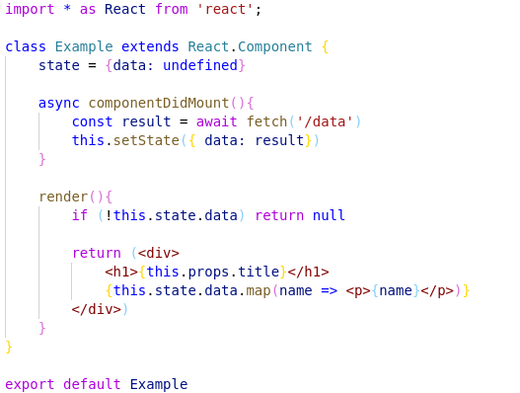
Recap
React
1

Slide 3
Tips
Use VS Code: editor made for javascript
Use Eslint: javascript linter
Use Prettier: formatter (add formatOnSave: true to settings.json)
Use Typescript: typed javascript
React
1

Slide 4
Format
<Subject />
Theory
Hands-on
Live coding (if needed)
React
1

Slide 5
What are we building?
Snippet
Authorization flow
Login functionality
Create accommodation
Connect to Redux
React
1

Slide 6
But first: Getting started
Git clone or git pull https://github.com/AMIS-Services/react-series
Cd into dir sig3/exercise/koa, run:
`yarn` / `npm install`
`yarn stop-db` / `npm run stop-db`
`yarn start-db` / `npm run start-db`
`yarn start` / `npm start`
`yarn seed-db` / `npm run seed-db`
Visit localhost:3030/accommodations to verify back-end is working
Cd into dir sig3/exercise/react, run `yarn` or `npm install` and `yarn start / npm start`
Visit localhost:3000 to verify front-end is working
React
1

Slide 7
Snippets
Prevent you from writing boilerplate
Can be project specific or saved globally
Are applied through autocomplete
React
1

Slide 8
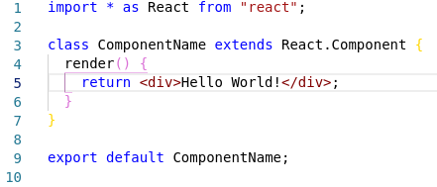
Hands-on: Snippets
Navigate to file > Preferences > User Snippets
Select New Snippets file for exercise
Create a template resulting in the code below
Use `$1` for the component name
Docs: https://code.visualstudio.com/docs/editor/userdefinedsnippets
React
1

Slide 9
Context API
Provides a way to pass data through component tree
Prevents you from ‘prop-drilling’
When: sharing ‘global’ data
Like: current authenticated user, theme, preferred language
React
1

Slide 10
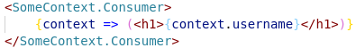
Context API
Requires initialization, a provider and one or more consumers
Initialization is done outside of a component:
The provider is passed the value:
Child of Consumer is a function:
If you want your context available outside of the render method, set the classes contextType below the class:
N.B. Export context API from it’s own separate file to prevent cyclic dependencies when using the contextType notation
N.B. If you want to pass functions, put them in state and pass the whole state object
React
1

Slide 11

Hands-on Time!
Login
Functional Demo
React
1

Slide 12
Hands-on: Setting up a user context
Create a file called context.js in `src/common`
Initialise a context called UserContext and export it
Import the context in Frame.js and wrap it in <UserContext.Provider />
Add state to the Frame component, consisting of a currently undefined user and a login function
In the login function, use the login function from src/common/auth.js. Set state.user to the user returned by the login function
Make state accessible by passing it <UserContext.Provider value={this.state} />
Wrap the JSX the Appbar returns in a <UserContext.Consumer /> and conditionally show either the users userName or the word login, depending on whether user is logged in or not
Test whether context works by calling this.state.login() from componentDidMount lifecycle method in Frame.js.
BONUS: Add logging out
React
1

Slide 13
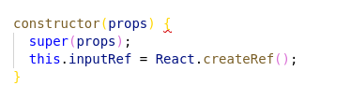
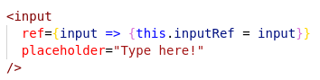
Uncontrolled forms
Initialise the ref in the constructor:
Use a callback to link the DOM element to the ref
The value of the ref is available in `this.inputRef.value`
N.B. Material UI <Input /> or <TextField /> use inputRef instead of ref
React
1

Slide 14
Hands-on: Uncontrolled form
Create a LoginDialog component, pass it the properties open (a boolean) and handleClose (a function)
In the render method, return a MUI <Dialog />. Pass it the property open from your LoginDialog props.
Add two Inputs for email and password as well as a Button from MUI
Initialize two refs in the constructor and add them to the Inputs using callbacks in their inputRef property
Create a handleLogin function and add it to the onClick of the button.
Below your class, add `LoginDialog.contextType = UserContextAdd the login logic from your context to your handleLogin function.
Change the <Appbar /> render to contain the <LoginDialog />. Add the necessary functions and state members to manage the `open` prop of the LoginDialog. Pass LoginDialog the necessary function in handleClose
BONUS: make the ‘favorite’ on the accommodations work again. The favorite accommodations list can be found on the user object.
BONUS: add validation to the ‘email’ field of the login dialog
React
1

Slide 15
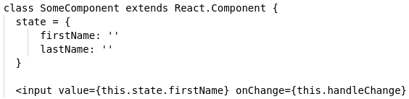
Controlled forms
Input values are kept in state
Each input should have its own value prop set to the corresponding state member
Each input should have its handleChange prop set to a function which will update the state
React
1

Slide 16
Hands-on Time!
Create accommodation form
Functional Demo
React
1

Slide 17
Hands-on: Controlled form
Add a new page at `/create`
Add a routerlink inside the Appbar, linking to /create
The link should only be visible/clickable to logged in users
Add a MUI TextField for name, location, foto url, description and a MUI (multi)select for amenities (faciliteiten)
See: https://material-ui.com/api/select/
Have the input values depend on state and add functions for the inputs’ `onChange`
Add a submit button which posts the accomodation to `localhost:3030/accommodations` using the fetch function from ‘src/common/fetc’
Bonus: add a create new user page at `/register`
React
1

Slide 18
Redux
Action
Reducer
Store
React
1

Slide 19

Redux
Action
React
1

Slide 20
Redux
Action
React
1

Slide 21

Redux
Reducer
Action
React
1

Slide 22
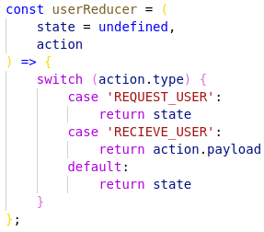
Redux
Reducer
Action
React
1

Slide 23
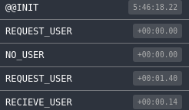
Redux
Reducer
Store
React
1

Slide 24
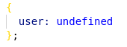
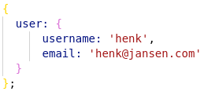
Redux
Reducer
Store
React
1

Slide 25
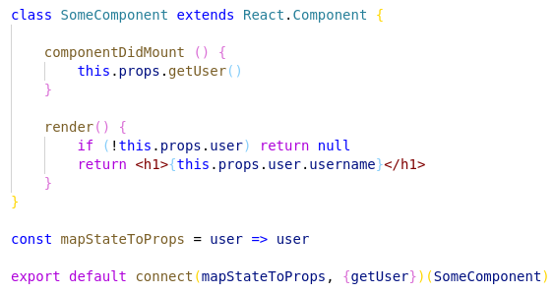
Redux
Component
Store
React
1

Slide 26
Hands-on Time!
Redux / Redux devtools
Functional Demo
React
<number>

Slide 27
Hands-on: Redux actions
Create a file: src/store/accommodations/actions.js
Export a function getAllAccommodations which returns an async function which takes a parameter called dispatch. HINT: this async means you will want to use `await`.
In the returned function, dispatch an object with the attribute type set to “REQUEST_ACCOMMODATIONS”
Move the accommodations fetch from Accommodations.js to here
If the Fetch is successful dispatch a second object with type “RECEIVE_ACCOMMODATIONS” and the accommodations as payload. If the Fetch is unsuccessful dispatch an object with type “ERROR_ACCOMMODATIONS”
Suggestion: put the type strings in a constant which you export, so you can use the same strings later
React
<number>

Slide 28
Hands-on: Redux reducer
Create a file: src/store/accommodations/reducer.js
Add the reducer function
It takes a state (default empty array) and an action (default empty object)
It contains a switch for the action.type
By default it returns the state
Add a case for ‘REQUEST_ACCOMMODATIONS’, ‘ERROR_ACCOMMODATIONS’ and ‘RECEIVE_ACCOMMODATIONS’
In the request and error case return state
In the receive case put the accommodations you just fetched in the state
React
<number>

Slide 29
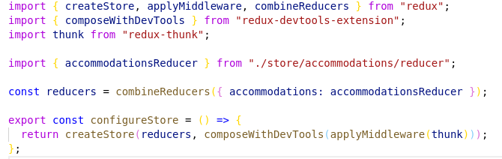
Hands-on: Store
Create a configureStore.js file
Add the following code:
React
<number>

Slide 30
Hands-on: View
In the Accommodations component, wrap your export of Accommodations in the connect function imported from ‘react-redux’
Create a mapStateToProps function, which will map your global store state to your component props. It takes Accommodations as a parameter and returns it
Create a mapDispatchToProps object. It has the key getAllAccommodations and the value getAllAccommodations, which you should import
Pass the two maps to your your connect as parameters
Remove the fetch from your componentDidMount()
`console.log()` your component props and use your newly available props to get and show the accommodations
React
<number>

Slide 31
JSS
Last time we covered JSS
But no hands-on due to time constraints
It is CSS inside your javascript file
No inheritance of parent to child components
More control
Can be injected into component by WithStyles (Material UI)
Some syntax specific changes compared to CSS
React
<number>

Slide 32
Hands-on: JSS
Translate CSS file to JSS
React
<number>

